Slide 1
Codiac Vikings Aquatic Club
New Parents’ Orientation Meeting

Slide 2
Agenda
Competitive Swimming 101
Club Business
Time Standards
What does that mean
Swimming Strokes
Swimming Lingo
Foods and Nutrition
What to wear
Apps
Volunteering
Officials
Special Events
Club Communications
Contacts

Slide 3
Swimming 101
#1 goal: HAVE FUN!
Train at different times and intensity – depending on level (Tidal/Wave Performance, Swell 1&2, Ripple 1&2)
Swim meets – Premier Invitational, Provincial, National, etc.

Slide 4
Club Business
Sign the code of conduct with their parent(s) present – parent can sign for the younger kids
All parents must: Sign the parent code of conduct (when registering)
Purchase and wear (to meets) an official current CVAC t-shirt and CVAC cap

Slide 5
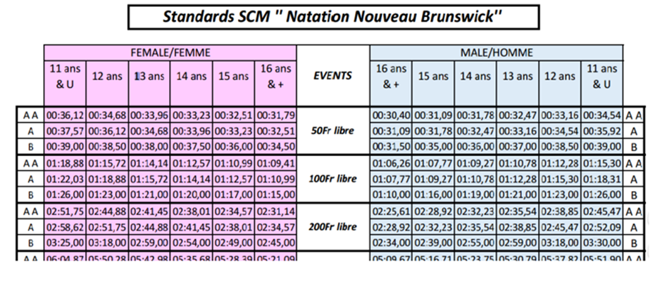
Time Standards
Different time standards depending on the type of meet
https://www.swimnb.ca/wp-content/uploads/2019/10/2019-2020-SNB-Standards-LCSC-1-Page.pdf
Example- see table

Slide 6
What does that mean?
Time qualifications for meets:
Each meet sets their qualification requirements depending on the type of meet
Ie. “no time standards”, two NB “A” times, three NB “B” times, Age Group times, Easterns
SCM Short Course = 25 meter pool
LCM Long Course = 50 meter pool

Slide 7
Swimming Strokes
Freestyle – Referred to as front-crawl by non-swimmers. The stroke involves repeatedly flailing your arms in a windmill motion while performing the flutter kick. Freestyle events offered are the 50M, 100M, 200M, 400M, 800M, and 1500M distances along with relays and open water events.
Backstroke – Sometimes called “back-crawl”. Take freestyle and turn it backwards and you’ve created a backstroke. Backstroke events offered 50M, 100M and 200M distances.
Breaststroke – Sometimes called the “frog stroke”, this is the slowest of the 4 swimming strokes. To successfully swim breaststroke, you must propel your body forward, making a scooping motion with your arms, while also completing a frog kick with your legs. Breaststroke events offered 50M, 100M, and 200M distances.
Butterfly – Sometimes called “the fly”. This stroke involves flinging your body back and forth, swinging your arms over your body in circular motions, creating pain, while also managing not to drown. Fly events offered 50M, 100M, and 200M distances
IM (Individual Medley) – The swimming version of the gymnastics “all-around”, involves swimming all 4 strokes in the order butterfly, backstroke, breaststroke, freestyle. IM distances offered 100M, 200M and 400M

Slide 8
Swimming Lingo
SCM Short Course = 25 meter pool
LCM Long Course = 50 meter pool
Time qualifications for meets:
Each meet sets their qualification requirements depending on the type of meet
Ie. “no time standards”, two NB “A” times, three NB “B” times, Age Group times, Easterns

Slide 9
Swimming Lingo
Start – Alternative word for dive used to refer to the initial dive a swimmer does off of the blocks at the beginning In backstroke, a start is performed in the water Coaches often initiate a start by saying “take your marks, go”.
Flipturn – The sequence performed when a swimmer reaches the wall at the end of their 25 or 50 in freestyle or backstroke that involves somersaulting into the wall, touching it with two feet, and then pushing off the wall.
DQ – No, not Dairy Queen, much worse than ice cream. Getting a DQ means that you’ve been disqualified from your race.
Official – The people in white shirts at swim meets, responsible for maintaining the rules and crushing the dreams of swimmers.
Starting Block- The mounted platform a swimmer uses to dice into the water. When a coach says “get behind the blocks, “ this means a swimmer should get behind their respective block in anticipation of their heat.
Lane line – The plastic dividers that separate swimming lanes.

Slide 10
Swimming Lingo
Marshalling area - The area on the pool deck where swimmers are “marshaled” prior to the race. Sometimes, rows of chairs will be set-up, with swimmers being assigned to a particular row along with the other swimmers in their heat. This is more typical of swim meets with younger swimmers.
Event – the overall events your child swims (50 free, 100 breast, 50 back, 100 Fly, etc.
Heat – the race your kid will swim in (against the other kids swimming in the same race)
PB – personal best time
Heat sheet/Psych sheet - A list of the day’s events, usually paper-bound, that lists the participants in each lane, their seed time, lane, and the heat they are in. Races are arranged by event number.

Slide 11
Food before & during meets
On deck it's always good to snack on foods that are easy to digest such as:
Low fiber cereal (less than 2 grams per serving)
Pita bread or Naan bread
Cooked pasta either plain or with olive oil and Parmesan cheese or non-spicy tomato sauce
Dried fruit
Yogurt, yogurt tubes, yogurt drinks
Blueberry and/or pancakes
Fruit-to-go bars
Fruit smoothies
Graham crackers
Pretzels
Plain sandwiches - bread product with lean meat.
Make sure to have a supper meal that is rich in carbohydrates and protein the night before the meet. Pasta, rice, or sweet potato eaten with lean meat/poultry or fish would be examples.

Slide 12
Food during meets
Some kids eat, some don’t… they still need to have snacks with them on deck
Healthy food ONLY
– Carbs (cooked plain pasta, crackers, etc.)
– Minimal veggies
– Minimal protein – save this for after the meet
– Nothing new – swim meets aren’t the time to try new foods
Swimmers also need to drink – water, etc. – at practice and meets
Absolutely NO NUTS on deck for practice or at meets

Slide 13
Fueling your athlete
Quick and simple tips to fuel your athlete in the pool
Proper nutrition during multiple training days and meets provides
Sustained energy from foods and fluid high in carbohydrates, adequate in protein, and lower in fat and fiber
Mental focus for best techniques and skill execution in the pool
Adequate hydration and electrolyte balance
Adequate energy and nutrients to recover and prepare for the next training session or meet
How much fluid do simmers need?
Training and competing in hot humid pool environments can increase sweat loss which is difficult to determine since athletes are wet from the pool and varies from athlete to athlete. Here are some general guidelines to follow
Athletes should weigh themselves pre and post training: For every 1kg lost, replace with 1.5litres of fluid
Athletes should check their urine if they have not produced any urine, or if it is bright and yellow, they should drink 3 to 5ml of fluid per kg body weight (about 150 to 350ml fluid) about 2hrs before exercise.
https://coach.ca/coachs-kitchen

Slide 14
What to wear at meets
CVAC Clothing!!!!
MUST wear team shirt
Navy or team logo sweatpants
CVAC Cap
Codiac Vikings Store (company.site) to purchase all your clothes
Racing suites
You’ll see lots of knee-length suits at higher level meets- This is not required and would be discussed with the coach first

Slide 15
Apps to use at meets
Meet Mobile provides real-time meet results and standings from anywhere, at any time.
Free App, some functionality requires a subscription

Slide 16
More Apps
Parent OnDeck
Gives access to your swimmer's times, meets, etc.
Free app

Slide 17
Volunteering
The BEST way to learn about CVAC and competitive swimming is to get involved! We need your help!
Everything done for CVAC is done by volunteers
Officials at swim meets
Committees
Special skill we might need? Let us know!

Slide 18
Fundraising/Sponsorship
We have lots of options help with the cost of swimming! We are always looking for new ideas and sponsors.
Garbage Bags
Coffee
Fundscrip
Do you know any businesses that would be interested in being one of our sponsors?

Slide 19
Officials
!
Best seat in the house at swim meets
Need a large number of officials at every meet
Different levels of officiating
Timekeepers
Strokes and Turns
Etc
Stay tuned for a Timekeepers training course

Slide 20
Special Events
Welcome back BBQ
Halloween Glow Swim
Santa Clause Parade
Holiday Party
Year end Banquet

Slide 21
CVAC Communictaions
Check our website
https://www.teamunify.com/team/cancvac/page/home
Meet Schedule
Team Events
General Information
Contacts
Some things will also be sent as an email
Weekly Update
CVAC Families Facebook page to relay and ask for info (closed group)
Codiac Vikings Facebook page (open/public group)
Instagram-@codiac_vikings https://www.instagram.com/codiac_vikings/

Slide 22
Contacts
Have a question? Ask!
Coaches: if it’s a question about training, your swimmer’s participation in a meet, etc. – talk to your child’s coach. They are always available after practice!
Anything else: ask one of the Board or Committee Chairs/Members (all board members emails are listed on the website)
president@codiacvikings.ca
treasurer@coadiacvikings.ca
teammanager@codiacvikings.ca

Slide 23
Questions?

