Slide 1
New Member Orientation October 2023
4:45-5:30pm
&
5:45-6:30pm
October 25, 2023

Slide 2
AGENDA
Welcome & Intros
Financial Process
Bingos
Participation Points
About Competitive Swimming
About Edmonton Keyano
More from the Development Program
Questions

Slide 3
Welcome & Intros
General Manager
Head Coach
Lead Development Coach

Slide 4
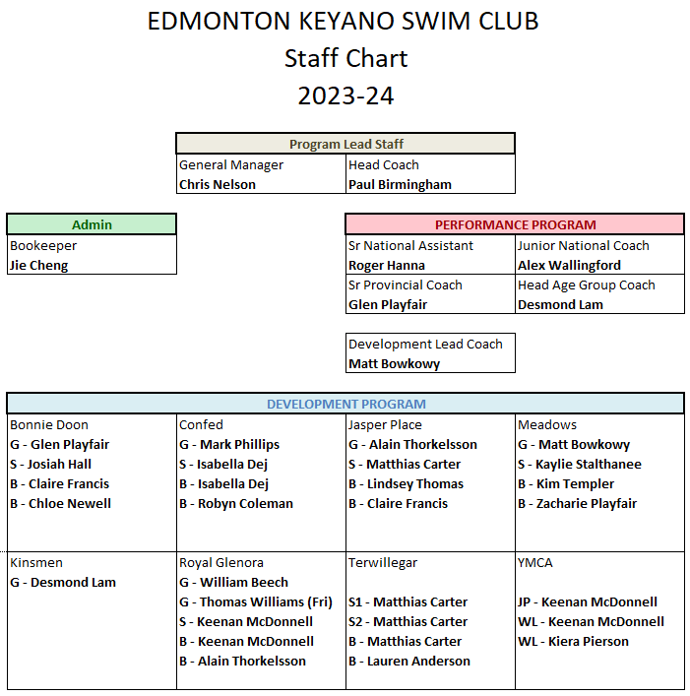
Staff Chart

Slide 5
General Manager
Chris Nelson
Keyano’s first GM, GM position created in 2018
Formerly, Head Coach & GM were one position
Chris brings 20 years of coaching and administrative experience from Alberta swim clubs, including 7 years of coaching on international stage, 20 years of work on Swim Alberta and City of Edmonton stakeholder working groups & committees.

Slide 6
Head Coach
Paul Birmingham
Head Coach since 2018
Previously National Coach of Malaysia for 11 years
Resume includes Performance highlights of 4 Olympic Games and multiple World Championships; and Development highlights from 2000+ member swim schools / clubs in Australia and California.

Slide 7
Lead Development Coach
Matt Bowkowy
New position created in 2022 to add oversight to Development programs.
Matt brings 20+ years of coaching experience including Head Coach of 2 previous programs in the Edmonton area.
Implements the club curriculum and creates professional development sessions all season long for coaches.

Slide 8
Financial Processes
Fee Definitions
Monthly Process
Policy Highlights
FAQ’s

Slide 9
Fee Definitions
Registration Fee
This is a one-time annual fee that pays for membership with Swim Alberta and Swimming Canada on your behalf. That membership is activated the moment you register with Keyano and is valid until August 31st of each year. This fee does not stay in the club and is therefore not refundable.
Membership Deposit
This deposit is held in trust for members until the end of a swimming season, which is officially August 31st each year. It is held until such time that all of a member’s commitments are fulfilled and may be refunded after all account balances are complete and paid for the current season. Members also have the option to carry a deposit forward to the following season.
Training Fee
This fee represents the annual cost of training, which includes employing staff and renting pool lanes from the city. This fee is not pro-rated according to a swimmers’ attendance. EKSC begins its season in September and continues until June (some swimmers may qualify to continue into the Championships season in July/August). Fees are due in September and can be paid in full up front, or in 10 equal installments (this option is for the member’s financial convenience only). Installments are a monthly payment plan for annual fees and are not equivalent to the value of training each month.

Slide 10
Monthly Process
Invoicing
Within the first 10 days of every month, invoices are created and charged automatically to your method of payment on file. Monthly invoices are never considered overdue until after the 10th of the month.
Multi-Swimmer
Families with multiple swimmers have their fees adjusted with a 5% discount for any additional swimmer after their highest placed swimmer in the program. Families also receive a $50 registration discount for multiple swimmers.
Prorate for Move ups, registration changes
Training fees are set to start the season, but if a member changes their group mid-season then the club will manually prorate your fees and commitments to the % of the season you are active in any given group.

Slide 11
Financial Policy Highlights
>30 days in arrears
Members have an obligation to their fees and commitments based on their registration. Should a member fall more than 30 days behind on their payments then they must communicate with the bookkeeper to arrange payment as soon as possible. Failure to communicate or further failure to make payments may result in a swimmer being removed from the program.
Non-Training fee expenses
Swim meets, equipment and other sign-up expenses become non-refundable after the sign-up deadline. Note that Keyano makes payments on behalf of members based on their sign-up and once those funds are non-recoverable to Keyano they must be charged to the member who made the request.
In-town Swim Meet expenses
All sanctioned competitions come with entry fees to cover the cost of event rentals (facility, timing infrastructure, etc) and Swim Alberta sanction fees. These fees are mandatory after the entry deadline (the club’s deadline may be different that an event deadline so we can get our entries in on time to reserve space in a swim meet).
Travel Swim Meet expenses
When coaches and swimmers travel the costs of travel are shared amongst participants. Cost of coach travel are shared amongst all participants, while team travel costs are shared only amongst those who partake in the team travel portion of the event.

Slide 12
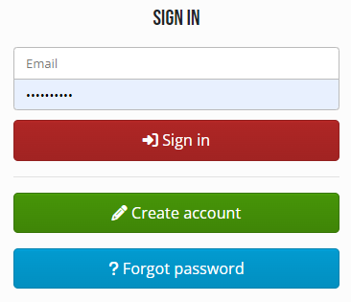
FAQ’s
What is on my invoice?
After a payment you will be emailed a receipt. This is not a copy of your invoice – you must login to see your invoice at www.eksc.com.
SIGN IN Go to sign in at top right. | Go to My Account Click on your email address at top right to bring down this option. | Billing Click Billing to view all account history, including invoices.

Slide 13
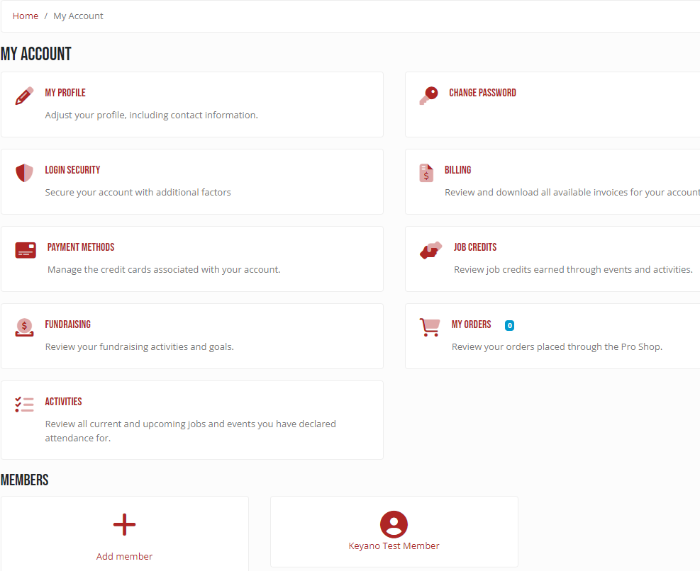
FAQ’s
Navigating My Account
You have several options on your account. Please keep your account up to date with current address, credit card, and use your account to access important information at www.eksc.com.

Slide 14
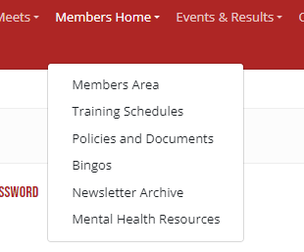
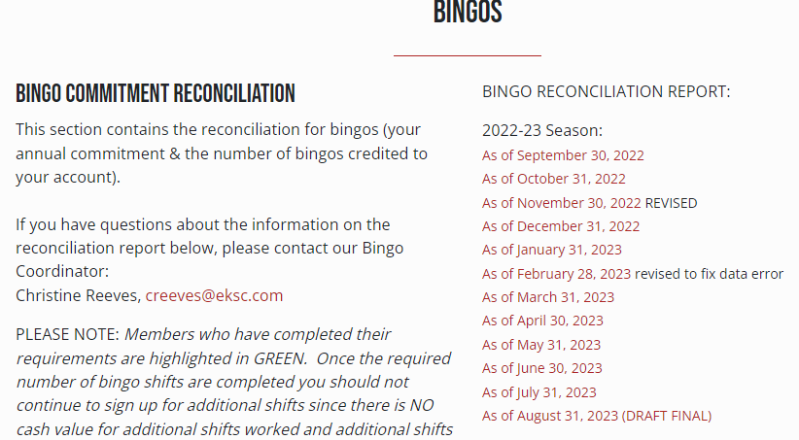
FAQ’s
Review Bingos on Bingo Page
While logged in, go to the Members Home > Bingo to see your family commitment status for bingos.

Slide 15
Bingos
What is a Bingo?
Policy Highlights
Sign up

Slide 16
What is a Bingo?
What does a volunteer do at a Bingo?
Most members will sell small cards for $1 to public patrons at a bingo event. With experience some members will take on controller roles that handle the dispersement of cards and cash during the event. All roles are simple and basic selling roles are trainable on the spot. The bingo halls ask only that our volunteers do their best while selling cards, enjoy social time with other club parents during breaks and down time, and act and dress appropriately (clean shirt and jeans / pants are the norm).
Why Bingos?
Bingo fundraising is a staple for youth sports in Alberta. At Keyano, pool rental costs are over $500,000 per year - luckily proceeds from our bingo events have been upwards of $300,000 in 2022-23. This amounts to approximately $200 per bingo shift worked by a Keyano volunteer and several thousand dollars per bingo event.
Where do Bingo proceeds go?
Bingos offset your fees, plain and simple. The proceeds of all AGLC events are controlled and must be applied to costs that benefit all members, like pool rental.

Slide 17
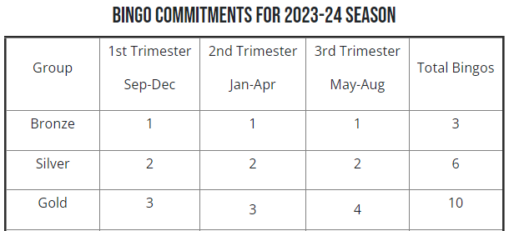
Bingo Policy Highlights
Bingo Commitments
Members have a bingo commitment based on the group in which they register.
Your bingo commitment belongs to you. You may make arrangements for someone to help you with your commitment, but the ultimate responsibility is still up to you to complete your commitment.
Trimesters
Trimesters are a maximum, not a minimum for the given timeframe. Trimesters limit anyone from taking up all of the position early in the year and allows for more members to access the sign up for events all year long.

Slide 18
Bingo Policy Highlights
Bingo Decline
Members have the right to decline their bingos, no questions asked, for an increased training fee of $200 per bingo in your commitment.
Deadline is August 31, annually
Any bingos that are not completed by August 31 annually are subject to a $200 training fee.
Extra Credit
Members are allowed to volunteer for bingos beyond their commitment so long as there are openings for volunteers. Members may receive a $60 account credit per bingo volunteered in excess of their commitment (AGLC maximum value).

Slide 19
Bingo Policy Highlights
No Shows
Bingo Halls must meet AGLC requirements for volunteers. A No Show violates AGLC requirements and thus can result in a $1,000 fine to the club and possible loss of future bingo events.
No Shows under Keyano policy result in a fine of $300 and potential loss of privilege to volunteer at future events.
Sign-up period
Bingos are posted 1-2 months ahead after an announcement to all members of the posting date and time. Members may sign up for bingos up to their Trimester maximum at that time.
Sign up remains open until 10-14 days out from an event. At that point sign ups are closed and those signed up are committed to their volunteer shift.
Dropping Bingos after sign-up closes
Signing up for a bingo is a formal commitment. You may not drop a bingo shift after the sign-up period closes; however, you may try to find someone else to take the shift for you. Our Bingo Coordinator may help in this regard, however, remember that the shift remains your responsibility until someone else agrees to take it for you.

Slide 20
Sign up
No Shows
Bingo Halls must meet AGLC requirements for volunteers. A No Show violates AGLC requirements and thus can result in a $1,000 fine to the club and possible loss of future bingo events.
No Shows under Keyano policy result in a fine of $300 and potential loss of privilege to volunteer at future events.
Sign-up period
Bingos are posted 1-2 months ahead after an announcement to all members of the posting date and time. Members may sign up for bingos up to their Trimester maximum at that time.
Sign up remains open until 10-14 days out from an event. At that point sign ups are closed and those signed up are committed to their volunteer shift.
Dropping Bingos after sign-up closes
Signing up for a bingo is a formal commitment. You may not drop a bingo shift after the sign-up period closes; however, you may try to find someone else to take the shift for you. Our Bingo Coordinator may help in this regard, however, remember that the shift remains your responsibility until someone else agrees to take it for you.

Slide 21
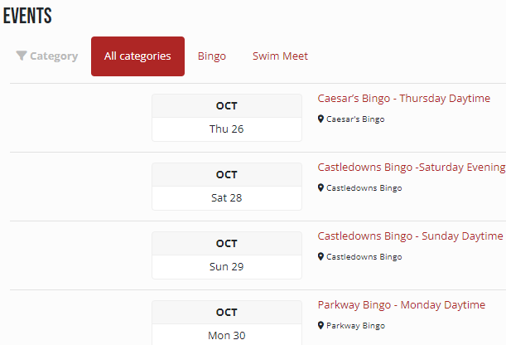
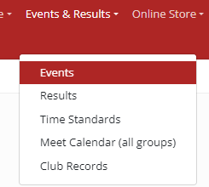
Bingo Sign up
Where do I sign up for a Bingo?
Please remember the date and time for your shift. Keyano has thousands of bingo shifts every year and every one of them is critical. Show up on time at the correct bingo hall location for your event.
SIGN IN Go to sign in at top right. | Go to Events Click on the menu bar once you have signed in. | Browse and Select your Bingo Select Job Sign-up to complete your sign up.

Slide 22
Participation Points
How are competitions organized?
Becoming an official
How to earn Points?
Policy Highlights
Sign up

Slide 23
How are competitions organized?
What are swim meets?
Swim meets are the target for our swimmers. Every group has a specific swim meet calendar, which you are expected to follow to the best of your ability. Here are a few bits about swim meets:
Meets take place one of two pool lengths: Short course (25 m) and Long Course (50 m);
Keyano runs Bear Cubs race nights to introduce swimmers to a swim meet setting;
Novice meets are open to any swimmer, whereas some meets have qualification standards;
Meets can be local or require travel to another city nationally or internationally;
Qualification standards in swimming go off your actual age as of each competition, and not your year of birth like many team sports;
Costs for participation are independent of the financial membership requirements.
How do parents run swim meets?
Swim meets run anywhere from 8 to 16 lanes of racing at a time. Behind each lane at least 2 timers are required, as well as stroke judges and turn judges to watch for infractions. Add to that the referee, starter, electronics timing system operators, results and data desk, and usually a hospitality room and you have between 40-80 officials required per session at a swim meet. Our largest swim meet hosts 8 sessions, so you can see how parents play an essential role in officiating the sport.
Parents will start in simple roles like Timer. A swim meet session is typically 3-4 hours; swimmers will have a warm-up period prior to starting the race session.

Slide 24
More on Competitions
Meet level | Suitability / Description | Parent Role
In-house Race Nights (Bear Cubs) | This is for every little one. These are not sanctioned and therefore free for participants. Keyano runs these as an orientation to get new swimmers used to the environment of a swim meet. | We keep this as bare bones as possible. Usually need 10-15 volunteers for timing and data entry.
Novice Meets | Must have clearance from your coach to enter. These meets are shorter and have a marshalling area for swimmers to be corralled and shown to their lane for racing. | Keyano hosts a novice Friday night at Candy Cane. Volunteers needed when Keyano hosts.
Invitational Meets | Keyano hosts several of these, where out of town clubs come to compete. These will all have either a Qualifying Standard or a guideline. Swimmers will be invited based on their group. | Parents should be increasing their official certification to take on higher positions.
Provincial Meets | Swim Alberta awards their championship meets to Alberta clubs to host. Alberta Festival is for 10u girls / 11u boys Alberta Trials starts at 11u girls / 12u boys Alberta Championships is the highest competition in Alberta | Keyano volunteers are needed when Keyano hosts (average 1 championships per year)

Slide 25
Becoming an Official
It’s Easy – Learn the sport and get involved
Your first step is a Swimming 101 officials' course. This was attended by nearly 80 parents on Oct 11 (amazing!) and we will be offering follow up courses as the season progresses.
Being an official is… official
All Keyano parents become Swimming Canada officials. This is different from sports like soccer where the number of officials are relatively low.
After your first Swimming 101 course, you will be entered into the Swimming Canada officials’ database and receive login details to your online officials’ account. This is your personal account that will keep track of your officiating credentials throughout your time in the sport.

Slide 26
How to Earn Participation Points
Participation Points Commitment
Every member in Keyano has a participation points commitment. This starts with getting active in Bronze, and then a formal points commitment in Silver (35pts) and Gold (65pts).
How do I earn points?
Volunteer work earns Participation Points. Common ways to earn those include:
Group | Commitment
Bronze | 0*
Silver | 35
Gold | 65
* Get involved when your kiddos start racing ☺
Role | Points / session
Timer | 5
Stroke/Turn Judge | 7
Event Chair | 10
Meet Manager | 15

Slide 27
Points Policy Highlights
Commitment timeframe
Your points must be completed in the current season. Most points will be completed at one of Keyano’s hosted competitions (points can still be earned at other meets, but positions cannot be guaranteed):
Date | Hosted Competition | Target group level
October 14 | Octoberfest (1 pool session) | Bronze*, Silver, Gold
December 8-10 | Candy Cane Invitational (8 pool sessions) | Bronze*, Silver, Gold
January 19-21 | Blue Bears Invitational (4-6 pool sessions) | Silver, Gold, Provincial
February 2-4 | Edmonton Open (6 pool sessions) | Provincial, National
March 1-3 | Alberta Provincial Trials (6 pool sessions) | Gold, Provincial
July 4-7 | Edmonton Keyano International (8 pool sessions) | Gold, Provincial, National

Slide 28
Points Policy Highlights
Mandatory Special Contributions
On rare occasions, Keyano is the host of major national or international games. Keyano may have only 30-40 participants in a national meet or even 1-2 in an international one. In those cases, Keyano requires a broader member participation to run the event.
The Board may grant meet managers the ability to institute mandatory Participation Points at hosted meets. The mandatory requirements will be determined based on recommendations set by the Competitions Committee. Mandatory shifts are worth double points. If a member has already reached their maximum required points, there will still be an expectation to participate at hosted meets where mandatory shifts are required.
What if I miss my commitment?
We need everyone’s help to run our competitions and make lighter work for everyone. We need your help and do not want to charge anyone for non-fulfillment of their points commitment.
Unmet Participation Points commitments will be charged $5 per point not completed after the last swim meet of the season.
The non-fulfillment funds support hospitality budgets for officials and coaches at our swim meets.

Slide 29
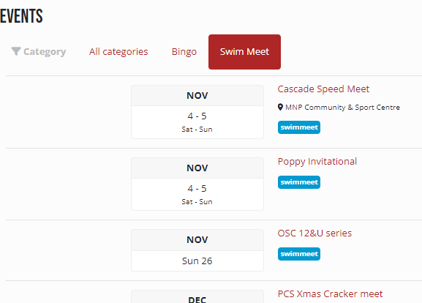
Participation Points Sign up
Where do I sign up as a Timer / Official?
Please remember the date and time for your shift. Show up on time to your shift.
SIGN IN Go to sign in at top right. | Go to Events Click on the menu bar once you have signed in. | Select your Swim Meet Select Job Sign-up to complete your sign up.

Slide 30
About Competitive Swimming
Training
(for swimmers, for parents, progression)
Swim Meets
(for swimmers, for parents, progression)

Slide 31
Swimmers
Coaches
Parents
Appreciation
Commitment
Goal setting
Learn
Commitment
Effort & Attention
Unconditional Love
Encourage
Physical support
Life skill support
Teach Skills
Detect & Improve
weaknesses
Moral support
Communicate
Support lessons
Same team
Communicate
Support parents
Same team

Slide 32
Training for Swimmers
Competitive Swimming
Swimming starts as a life skill; every child needs to learn how to swim. “Safety first” is why most of us got our kids into the water in the first place.
Keyano takes lessons to a new level. Within a very few short weeks new swimmers will become self-sufficient at travelling hundreds of metres on their own safely. But this is just the tip of the iceberg when you join Keyano.
Training Expectations in Development
Bronze swimmers must meet minimum swimming requirements and must also be mature enough to follow directions in a small group environment. It is expected that swimmers participate in local competitions, starting with in-house mini-meets.
Silver swimmers must be competent in all 4 swimming strokes. It is expected to compete regularly according to the group competition calendar.
Gold swimmers should be at a Festival standard and approaching Alberta Trials. It is expected to attend at least 80% of your training sessions and to increase communication to your coach about any absences.

Slide 33
Training for Swimmers
Other expectations
Arrive prepared, on time with training equipment.
Wear Keyano gear at practice and competitions.
Maintain positive attitude and communication with teammates, coaches and all others.
Outcomes for long-term swimmers
What are swimmers like if they stick with swimming into High School or University?
Hardy work ethic: Know the value of hard work and will get ahead many times.
Time management: Know how to balance work / life; swimmers are good students.
Goal setting: Know how to look set personal goals in life and make plans to attain them.
Long-term friendships: The bond of working hard together toward common goals lasts a lifetime.

Slide 34
Training for Parents
What to do during training
Avoid any contact with your swimmer during their training session. It may be tempting to coach from the side or motion to them to pay attention, but this has the opposite effect you intend. Swimmers must learn to listen directly to their coach during training. If a parent becomes a distraction even from the spectators’ area they may be asked to leave.
Stay off the pool deck. This is a safety and insurance issue amongst many other possible problems. Training sessions are for the swimmer and coach; parents may communicate with their swimmer or coach after the session is completed.
Make friends. Many lifelong friendships start with a chat in the stands. Remember to keep your talking on the positive side as negative talk can spiral beyond what anyone intends. Make swimming a happy place for you and your fellow parents.
Run errands. Ever felt your little one was slowing you down or distracting in the grocery store? You now have time to yourself to run a quick errand, grocery run, a workout, or grab coffee with a friend. Once your little one

Slide 35
Training Progression
When do swimmers move up?
Every season brings new levels of swimmers, different abilities, and different depth in numbers at all the group levels within Keyano. As such, there are no absolute criteria for moving up a swimmer. In lay terms, swimmers must:
Exceed the expectation level of their current group on the majority of learned skills.
Have no gaping deficiency in any of the major skills learned in their group.
Meet the expectation level of the next group on as many skills as possible.
Meet the expectation level of the next group in attendance, attitude, trainability, commitment & performance.
Be ‘age-ready’ as per the composition of the current groups.

Slide 36
Swim Meets for Swimmers
How to prepare
Participate at the meets in your group’s calendar. There is a progression from level to level, so do not miss out on early stages of learning.
Talk to your coach about goals. Goal setting starts as a coach-led process in Bronze and evolves to individual goal setting in the Performance groups.
During the meet, report to your coach before and after every race. Doing this ensures your goals for the race are fresh before and can be properly debriefed after your race. Visit friends and parents during longer breaks between races.
During the meet, stay focused. Electronics put a heavy strain on the neurons that fire to help us focus on other performances as well. If you need an on-deck past-time try a deck of cards or other simple game. Or, try cheering for your friends. ☺
During the meet, eat healthy. Pack simple snacks like crackers and fruit that replenish energy and electrolytes. After exercise it is really important to eat something healthy within 30 minutes (goes for training, too).
During the meet, stay hydrated with water (primary) and electrolytes. It’s okay for kids to have Gatorade, but still in moderation. Beware of fancy drinks that make big claims… some of these have caffeine or herbal supplements that are not declared (USA) or not meant for children.

Slide 37
Swim Meets for Parents
How to prepare
Help pack the snacks & drinks until your swimmers is old enough. A race suit is not necessary (even discouraged) until you get to higher level meets like our invitationals and Provincial meets.
Support with encouragement. Remember you have a coach to provide criticism and steps for improvement. Try to be oddly supportive of both great and not so great results and take an interest in letting your swimmer be the expert for you. Ask them what the coach thought, and if you’re not clear then ask your coach yourself. Things get awkward when a parent starts giving the criticism and the coach has to start doing the unconditional encouragement role.
Volunteer when possible. It won’t take every swim meet to complete your commitment, but this is one not to wait on. Try to get involved early – it’s actually a great seat from which to see the action.

Slide 38
Swim Meets Progression
Meet level | Suitability / Description | Qualifying Time
In-house Race Nights (Bear Cubs) | This is for every little one. These are not sanctioned and therefore free for participants. Keyano runs these as an orientation to get new swimmers used to the environment of a swim meet. | None. All novice swimmers are welcome.
Novice Meets | Must have clearance from your coach to enter. These meets are shorter and have a marshalling area for swimmers to be corralled and shown to their lane for racing. | None, but often a guideline like under 1:00 per 50m.
Invitational Meets | Meets that have broader attendance from around Alberta and Canada. Swimmers are expected to know their way around and the deck takes on a more professional feel. | Usually a qualifying standard. Each one will have a target of 2-4 group levels.
Provincial Meets | Level 1: AB Festival – this is for 10u Girls and 11u Boys who meet the qualifying standard. 2-day meet with all 50m and 100m events. Level 2: AB Trials – this is for all ages, but typically 11o girls and 12o boys. 3-day meet that offers all swimming events. Level 3: AB Provincials – this is for all ages and is a step up from Trials. | All Provincial Meets have Provincial Qualifying Standards.

Slide 39
About Edmonton Keyano
What Differentiates Keyano
History
Mission

Slide 40
What differentiates Keyano?
Wide Range of Programs
While obviously smaller in scale, Keyano runs the equivalent levels of Edmonton Minor Hockey all the way up to the Edmonton Oilers. Imagine if the Oilers ran a hockey club that started with 6-year-olds and culminated in making the big squad all without leaving Edmonton…
Our Development Program is one of the top on the country and focuses on skill and stroke development. This takes swimmers from grassroots racing up to the beginning experiences of Provincial meets.
Our Performance Program is one of the top in the country having placed multiple swimmers on Canada’s national team each and every decade since the club started in 1978.

Slide 41
History
Before 1978 Commonweath Games
Edmonton was already known as a swimming town with big names like Graham Smith (1 Olympic medal in 1976, 6 Gold in 1978 Commonwealth Games) and Cheryl Gibson (1 Olympic medal in 1976, 3 medals in 1982 Commonwealth Games).
After 1978, local swim club giants Jasper Place Swim Club and South Side Swim Club (out of Confed) joined to form Keyano and begin training at the new Kinsmen Aquatic Centre.
“Keyano” was the cree motto for the 1978 Commonwealth Games in Edmonton and means Friendship.

Slide 42
History
Olympic Glory
26 Swimmers, Coaches and Staff have been named to Canada’s Olympic team from Edmonton Keyano.
This being an Olympic year, keep your eyes on Keyano’s Emma Finlin who last season posted the 4th-fastest 1500m Freestyle in Canada all-time and named to Canada’s 2023 World Championships and Pan Am Games teams.

Slide 43
Mission
Unapologetically Performance-Driven
Keyano aims for a lot of goals, but all are driven by the mission to perform.
While many clubs get bogged down in the politics or competitive friction created by this goal, Keyano’s board and staff have always strived for excellence and when faced with tough choices choose to support performance.
We believe everybody and Keyano benefits from the drive of our Performance program and the type of leaders in swimming that Keyano is able to attract onto our staff.

Slide 44
More on Development Program
Lead Development Coach
Messages for the current season
(Questions are next ;)

Slide 45
Questions
Open to group questions ☺
Individual questions address as follows:
Policy / Club questions | Chris Nelson | generalmanager@eksc.com 780-777-9455
Basic Financial questions (change credit card, update account information, billing inquiries, etc.) | Jie Cheng | accountant@eksc.com
Program questions (group placement, training or equipment, swim meet sign up and entries, etc.) | Matt Bowkowy | mbowkowy@eksc.com 587-982-7025
Bingo Coordinator (Volunteer) | Christine Reeves | chrisrvs@shaw.ca
Officials Coordinator (Volunteer) | Stephanie Slee | officials@eksc.com

