Slide 1

SWAT 101 Information for Parents
October 7, 2023

Slide 2
Groups vs Competitions
SWAT Training Groups
Miniwaves
Tidal Waves
Novice
Junior P/A
Senior P
Senior A
Senior N
SNS/SNC Competition Groups
NovaTech
Age Group
National Level
**Note that achieving graduation time standards does not necessarily mean your swimmer move training groups.

Slide 3
Swim Meets
NovaTech (Miniwaves, Tidal Waves and Novice Groups)
Participation (In house)
Level 1
Level 2
Age Group (Novice, Junior and Seniors)
AA
AAA
National (Senior)
Easterns Canadian Championships
Canadian Junior Championships (CJC) / Canadian Swimming Championships

Slide 4
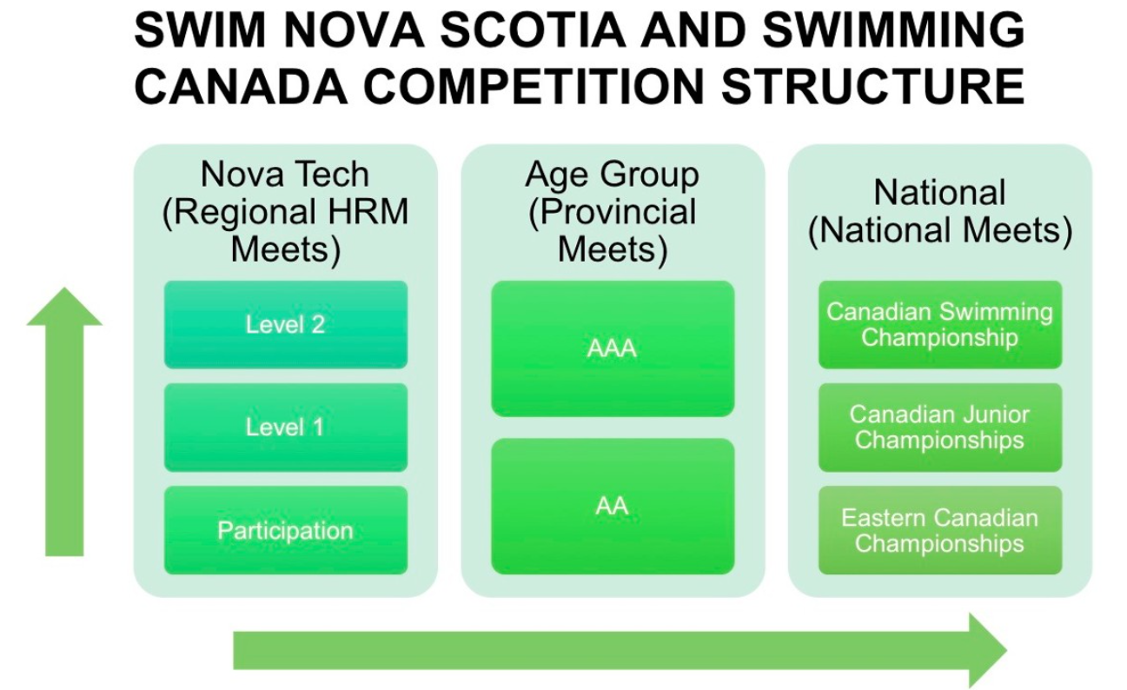

Slide 5

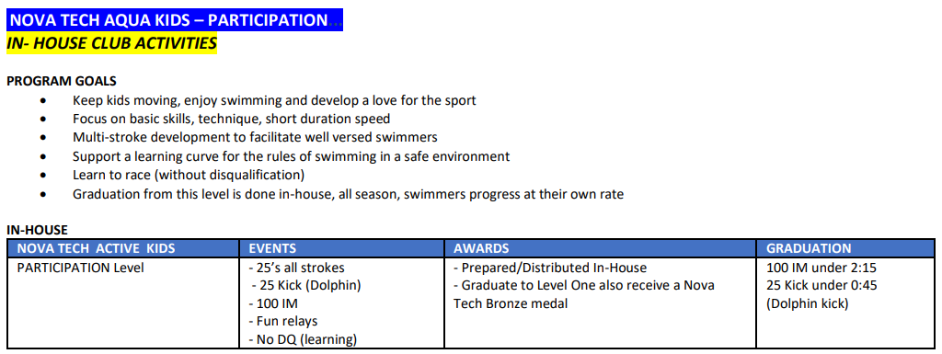
NovaTech – Participation

Slide 6
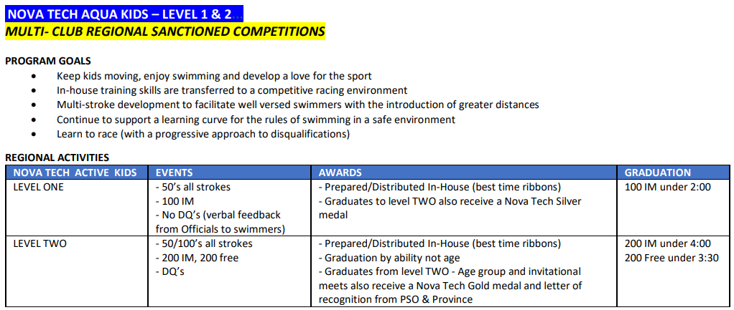
NovaTech – Level 1 and 2 (Central)

Slide 7
Age Group – AA and AAA
Must graduate from the NovaTech (NT) program before swimming in Age Group swim meets
Competitions are around the province, by age and gender
Season is combined in Age Group (AA and AAA) from September through December
In January, season splits between AA and AAA
AA swim meets are in 25m pools (SCM – short course meters)
AAA will race in 50m pools (LCM – long course meters)

Slide 8
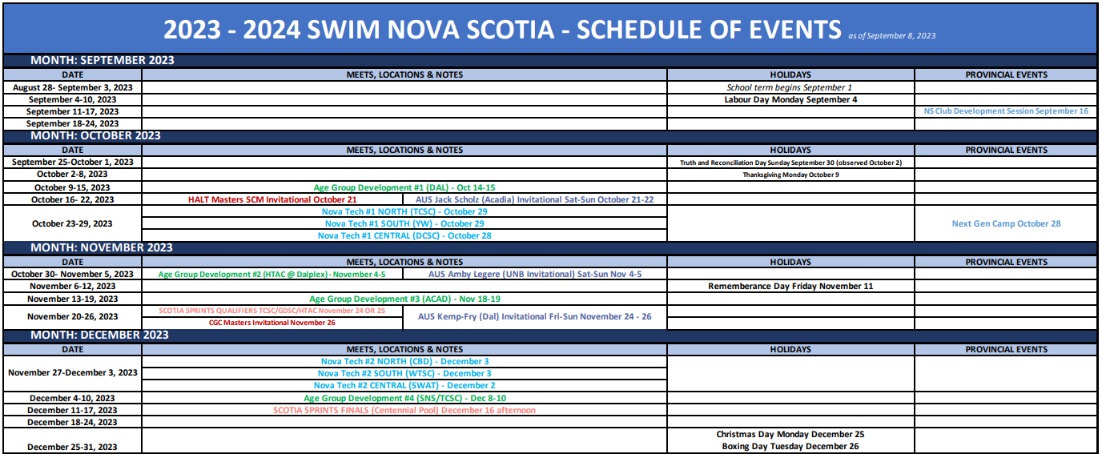

Slide 9
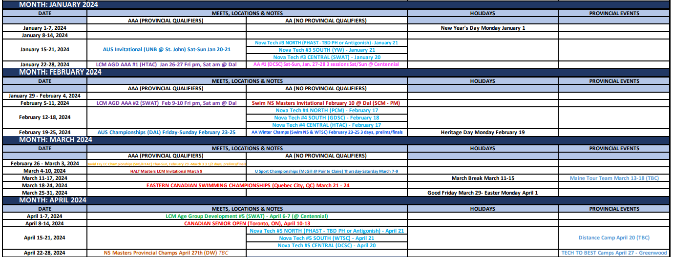

Slide 10
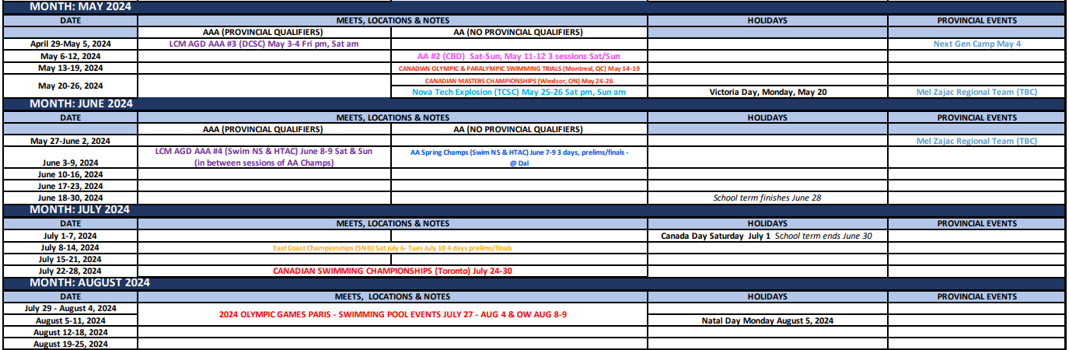

Slide 11

Team Unify (SWAT webpage)
To sign up for swim meets, events and volunteering for SWAT hosted swim meets

Slide 12
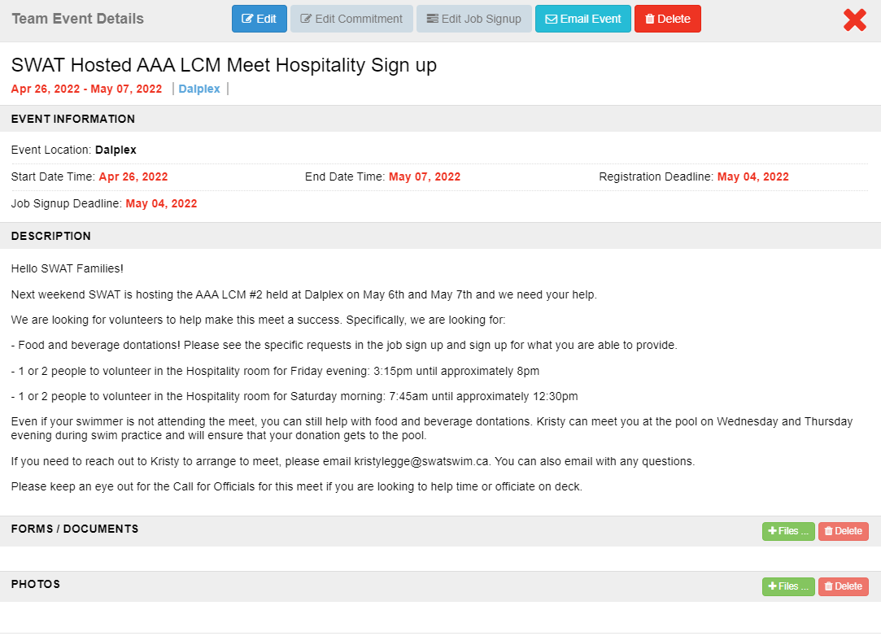

Slide 13
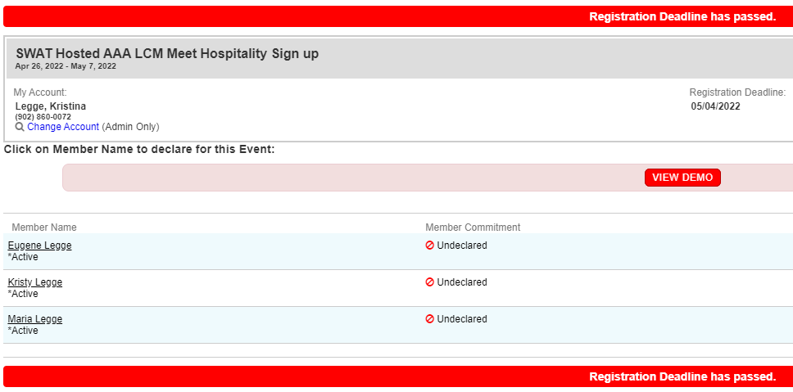
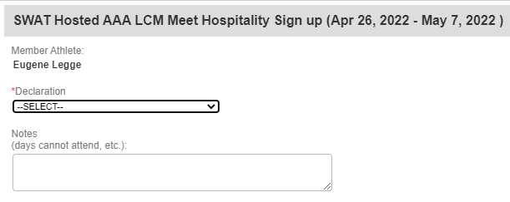

Slide 14
Important links
Swim Nova Scotia https://www.swimnovascotia.com/events
Schedule of events (can get updated throughout the season)
Lots of program information
Qualifying time standards
SWAT www.swatswim.ca
Swim Canada https://www.swimming.ca/en/events-results/live-upcoming-meets/

Slide 15

Volunteering
Officiating
On deck volunteering
Training
SWAT Board - Open positions
Communications Chair
Cost Recovery Chair
SWAT Travel Coordinator
SWAT Events and other ways to help
Special Events
Hospitality

Slide 16
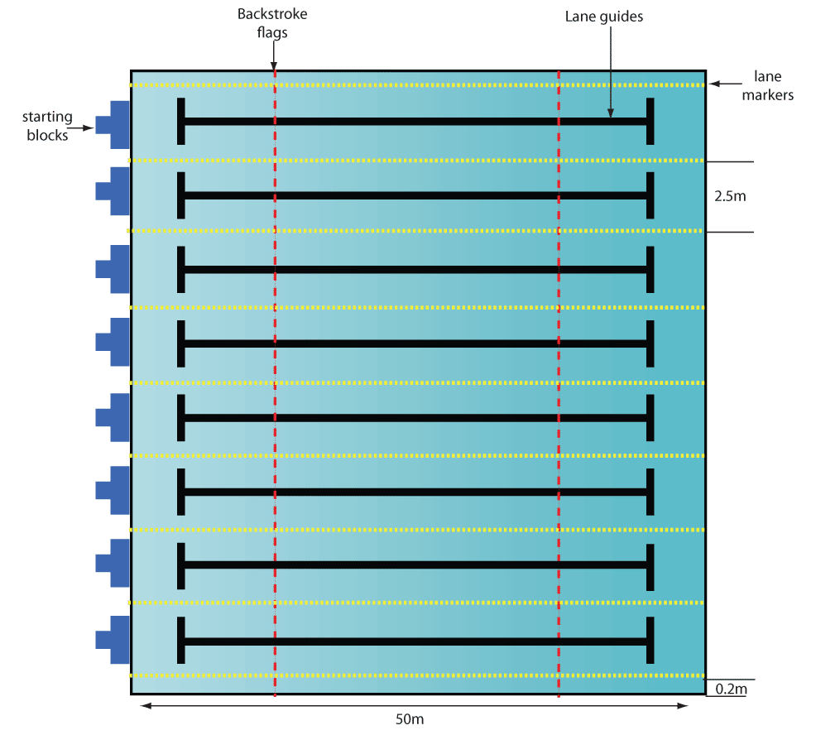
Officiating
Each swim meet requires a minimum of:
16 Timers (2 per lane)
2 Chief timers
6 Turn judges ( 1 per 2 lanes is better)
2 Stroke judges
1 Starter
1 Referee (2 for championship meets)
1 Electronics judge or Chief finish judge
1 Recorder scorer
1 Meet manager + Hospitality assistance
**Over 30 volunteers for each session!

Slide 17
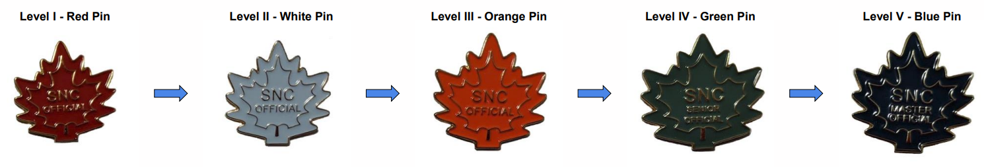
Officials Training
Level I – Red Pin
Level II – White Pin
Level III – Orange Pin
Level IV – Green Pin
Level V – Blue Pin
*Full information on the Officials Certification Pathway can be found here: https://www.swimming.ca/content/uploads/2023/09/Officials-Certification-Pathway-September-2023.pdf

Slide 18
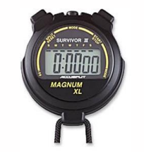
Level I – Red Pin
Complete the Introduction to Swimming Officiating clinic
Complete the Safety Marshal clinic
Complete registration in the Swimming Canada Officials Registration System

Slide 19
Level II – White Pin
Certify in Level I by obtaining 2 successful deck evaluations as a Timekeeper
Complete the Judge of Stroke clinic AND Inspector of Turns clinic and obtain 2 successful deck evaluations (1 as Stroke and 2 as Turn)
Complete one other Level II clinic and obtain 2 successful deck evaluations
Chief Timekeeper
Clerk of Course
Chief Finish Judge (CFJ) / Chief Judge Electronics (CJE)
Meet Manager
Starter

Slide 20
SWAT Volunteer Requirements
Group Name | First Child | Second Child
Senior National | $200.00 | $160.00
Senior Atlantic | $200.00 | $160.00
Senior Provincial | $200.00 | $160.00
Junior Atlantic | $200.00 | $160.00
Junior Provincial | $200.00 | $160.00
Novice | $100.00 | $80.00
Tidal Waves | $75.00 | $60.00
Mini Waves | $50.00 | $40.00

Slide 21
How to obtain volunteer points
Volunteer on the Board
75 – 200 points depending on position
Volunteer as an Official
15 – 40 points per session depending on level
Complete an Officials clinics
20 – 30 points per clinic
Teach an Officials clinic
30 – 40 points per clinic
1 point = $1 of volunteering commitment
More information on ways to obtain points:
https://www.teamunify.com/caswat/UserFiles/Image/QuickUpload/volunteer-points-proposal_057252.pdf

Slide 22
How to report your volunteer points
If you volunteer at swim meets or take officials courses, you will need to report your points to our SWAT Points Coordinator.
All you need to do is email Gabriel at recruitment@swatswim.ca and include the following information:
For swim meets:
Full name, your Officials level and number of sessions
For courses:
Full name, course name and level
**Please email right after the meet is completed

Slide 23
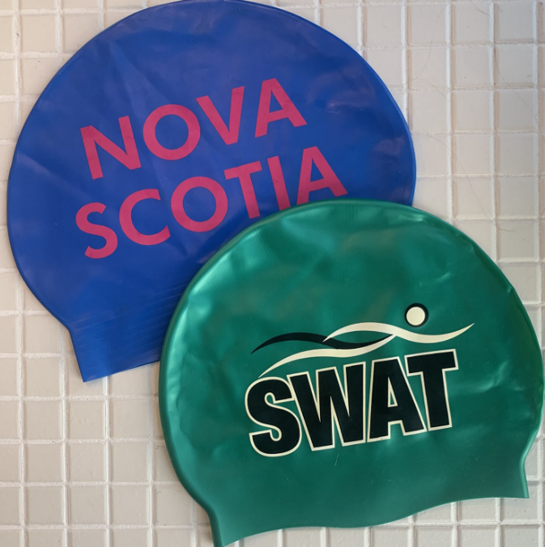
Equipment
Mini Waves:
Training suit (one piece for girls, jammer or brief for boys)
Swim Cap (one included in registration each year)
Goggles
Water bottle
Junior sized kick board (optional)

Slide 24
Equipment
Tidal Waves:
Training suit (one piece for girls, jammer or brief for boys
Swim Cap (one included in registration each year)
Goggles
Water bottle
Junior sized kick board
Short swim fins

Slide 25
Equipment
Novice
Training suit (one piece for girls, jammer or brief for boys)
Swim Cap (one included in registration each year)
Goggles
Water bottle
Junior sized kick board
Short swim fins
Swim snorkel

Slide 26

Questions?

